Slide 1
Lecture 1 – Introduction to Systems Engineering

Slide 2

Engineering Survival 101
This is a course in systems engineering
It is also a course that will describe many of the practices that are standard in engineering design “in the real world”
This class will provide you with a “survival kit” of concepts and terms that you will need to function in a modern engineering setting
It will put you significantly ahead of your contemporaries who will be struggling to learn this terminology and way of thinking “on the job”
Students with work experience will find out how many of the tools they use came into being and how to make many of them work
Notes:
Systems Engineering is a major field of endeavor in commercial and government engineering projects. This is particularly true in defense and aerospace projects. The elements of good systems engineering such as structured reviews and the jargon associated with it has become so ubiquitous, that it is most often used without explanation. This makes modern engineering discussions often seem like a foreign language of acronyms and terms to the newly minted engineering graduate. This course as an introduction to systems engineering can act as a “survival kit” for new engineers in this area, helping them to understand terms and concepts that they will use on a daily basis. Students with work experience will find out how many of the tools they use came into being and how to make many of them work

Slide 3
What is a system ?
group of independent but interrelated elements comprising a unified whole
wordnet.princeton.edu/perl/webwn
A system is an assemblage of inter-related elements comprising a unified whole. From the Latin and Greek, the term "system" meant to combine, to set up, to place together. A sub-system is a system which is part of another system.A system typically consists of components (or elements) which are connected together in order to facilitate the flow of information, matter or energy. ...
en.wikipedia.org/wiki/System
A collection of components organized to accomplish a specific function or set of functions. [IEEE STD 610.12]
www.ichnet.org/glossary.htm
A group of interacting, interrelated, or interdependent elements or parts that function together as a whole to accomplish a goal.
www.doe.mass.edu/frameworks/scitech/2001/resources/glossary.html
A combination of interacting or interdependent components, assembled to carry out one or more functions.
www.inspect1.com/ashi/glossary.html
A combination of several components or pieces of equipment integrated to perform a specific function.
thequalityportal.com/glossary/s.htm
Notes:
Some different definitions of system – important points are that a system is a combination of different but inter-related functions that accomplish a unified purpose. The big difference between a system and a pile of parts on the floor is that they are organized to accomplish a specific function, whether it is a computer, computer network, car, train, aircraft or spacecraft.

Slide 4
What is the system ?
Consider a commercial airliner. What is the system to be engineered ?
  The avionics (communications, navigation and flight controls and displays electronics)
  The entire airplane
  The airplane in the air traffic control system
  The airplane in the entire air transportation system (airports, maintenance, other transportation systems)
They are all systems to be engineered
Generally, most systems exist as part of a larger system
Generally we consider systems engineering to be at the highest level that accomplishes the function of interest
Notes:
Every system usually exists as a part of a larger system. We will use several system examples to illustrate this point.
For example the electronics that are the navigation and control electronics of an airplane are a system – a set of parts organized to perform a function
But then the aircraft us an entire system consisting of electronics, structure, hydraulics, engines and other systems
And a single airplane is just part of the entire air traffic control system
And a single airplane is also part of an entire support and logistics systems consisting of airports, maintenance depots, etc…
Systems engineering is the discipline we apply to ensure the successful realization of systems and is generally used to discuss the organization and integration of components at the highest level of that accomplishes the function of interest

Slide 5
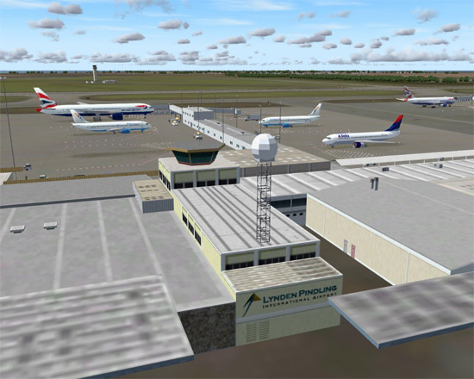

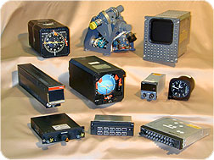

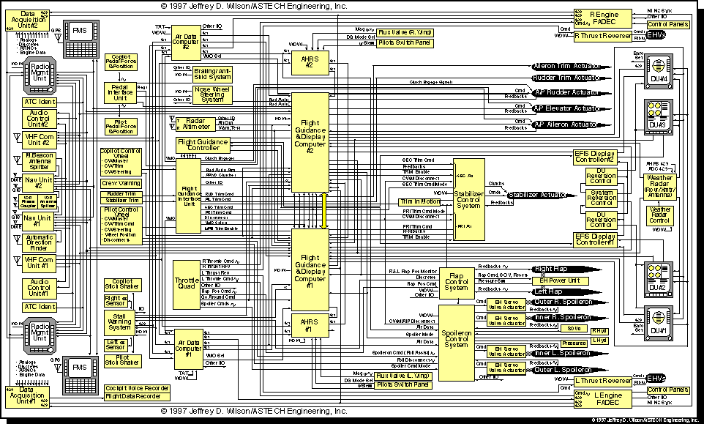
Airplane as a system
Airport as a system
Avionics as a system
Air traffic control system
Notes:
Illustration of the levels of systems regarding a commercial aircraft

Slide 6
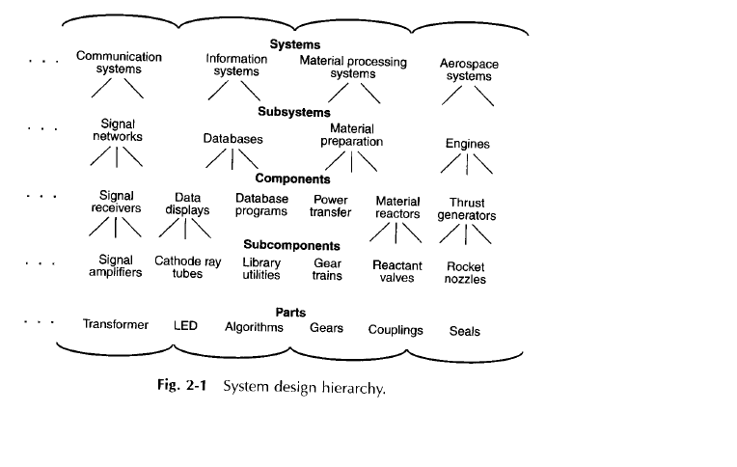
From Kossiakoff and Sweet
Notes:
From Kossiakoff and Sweet’s “Systems Engineering Principles and Practices” , Johns Hopkins Press
The hierarchy is important for common terminology.
It is interesting to note that although design of complete systems is the goal of most engineering projects, most of what is taught in a classical engineering curriculum is about parts, subcomponents and components. No wonder we have trouble with systems thinking and successful system implementation !
As a frustrated crew chief said in WW2 – “You don’t have an airplane there, you have a bunch of loose parts flying in formation”. Obviously loose parts can’t accomplish a systems function. They have to be integrated into a system to make anything work.

Slide 7
What is systems engineering ?
Wikipedia – Systems Engineering (SE) is an interdisciplinary approach and means for enabling the realization and deployment of successful systems.
It can be viewed as the application of engineering techniques to the engineering of systems, as well as the application of a systems approach to engineering efforts.
Systems Engineering integrates other disciplines and specialty groups into a team effort, forming a structured development process that proceeds from concept to production to operation and disposal.
Systems Engineering considers both the business and the technical needs of all customers, with the goal of providing a quality product that meets the user needs.
Notes:
Two important parts of systems engineering
Engineering the total system – not just parts
Applying a systems approach to the problems of engineering – for example what are all the activities necessary to produce a part of a car and how do they interact – design, manufacturing, quality inspection, test

Slide 8
What is systems engineering ?
International Committee on Systems Engineering (INCOSE) definition
Systems Engineering is an interdisciplinary approach and means to enable the realization of successful systems.
It focuses on
  defining customer needs and required functionality early in the development cycle,
  documenting requirements,
  then proceeding with design synthesis and system validation while considering the complete problem:
    Operations
    Cost & Schedule
    Performance
    Training & Support
    Test
    Disposal
    Manufacturing
Notes:
INCOSE – The international Committee on Systems Engineering is a wealth of knowledge.
They can be found at http://www.incose.org/
This is the first mention of the entire system life cycle and design to requirements we have seen. These themes will be present in many lecture sof the course.

Slide 9
What is systems engineering ?
(INCOSE definition Cont’d)
Systems Engineering integrates all the disciplines and specialty groups into a team effort forming a structured development process that proceeds from concept to production to operation.
Systems Engineering considers both the business and the technical needs of all customers with the goal of providing a quality product that meets the user needs.

Slide 10
What is systems engineering ?
Kossiakoff and Sweet
The function of systems engineering is to guide the engineering of complex systems
  Guide – “to lead, manage or direct, usually based on superior experience, in pursuing a given course”
  Engineering – “the application of scientific principals to practical ends”
  System - “a set of interrelated components working together to some common objective”
  Complex - “elements that are diverse and have intricate relationships with one another”
Notes:
From Kossiakoff and Sweet’s “Systems Engineering Principles and Practices” , Johns Hopkins Press

Slide 11
Systems Engineering and Traditional Engineering Disciplines
Systems Engineering is focused on the system as a whole.
  It looks at the system from the outside, at its interfaces and interactions with other systems, as well as from the inside
  It is concerned with external factors, such as the operational environment, as well as internal factors
Systems Engineering bridges the traditional engineering disciplines
  Various elements of the system cannot be engineered independently of each other
  For example – an aircraft is not a collection of parts flying in formation. The structure, the aerodynamics, the propulsion, the avionics and the internal systems must all work together
Systems engineers must guide and coordinate the design of individual elements to assure that the interactions are compatible and mutually supporting of the end goal.
Notes:
Disciplines are particular branches of engineering such as mechanical engineering or even subspecialties such as structural design, materials and mechanism design

Slide 12
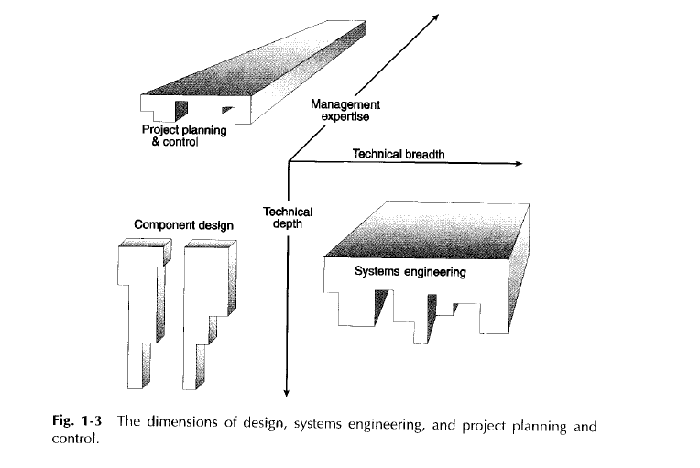
From Kossiakoff and Sweet
Notes:
From Kossiakoff and Sweet’s “Systems Engineering Principles and Practices” , Johns Hopkins Press
Component design is vertical – it sis a narrow set of concerns but is very detailed (i.e. how do I ensure that my part works)
Systems engineering and project management are broader – how does the system work. Project management bring larger management skills to bear (budgets, schedules, politics, customer issues) where the systems engineer is concerned with greater technical depth on how to “glue” the parts together

Slide 13
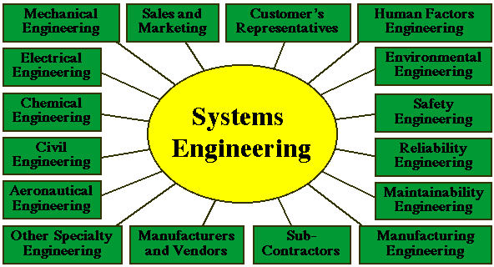
http://www.gmu.edu/departments/seor/insert/intro/SE/introrol.html
Notes:
Great diagram that shows all of the different disciplines that systems engineering must integrate

Slide 14
The Big SE and the little se
There are two types of systems engineering
The little se is about the book-keeping parts of systems engineering. Examples of se are
  Requirements decomposition and traceability
  Configuration management
  Process engineering
  Interface control
The Big SE is about understanding the relationships and interactions between system components and understanding the emergent behavior and integrated performance of the entire system. Examples of SE are
  Integrated systems modeling
  Integrated fault tree/hazard analysis
Most training in systems engineering focuses on se
  It’s easy to teach and the products are required on most government contracts
This course is going to do a balance of se and SE because in my experience, the SE is what is really important
Notes:
Much of what is taught in systems engineering is about compulsive behavior – such as making sure that every requirement in a higher level specification tracks to requirements in every lower level specifications document. This is good to do but is not about the larger issues of making systems work together.
In this course we’ll teach about the compulsive techniques but focus on the larger issues.

Slide 15
Characteristics of Successful Systems Engineers
Enjoy learning new things and solving new problems
Like a challenge
Are skeptical of unproven assertions
Are open minded to new ideas
Have a solid background in sciences and engineering
Have demonstrated technical achievement in a specialty area
Are knowledgeable in several engineering areas
  (a jack of all trades and master of one or two)
Pick up new ideas and information quickly
Have good interpersonal and communications skills
Most Important – CAN STEP BACK AND LOOK AT THE BIG PICTURE !
Notes:
Successful systems engineers have many characteristics different from successful component engineers.
Successful component engineers are focused on their specific craft. Systems engineers must develop broad knowledge to “glue” the parts of the system together but they must also be masters of one or two specific areas that are important for integration such as structures or software.
Most uniquely, they must have strong interpersonal and communications skills.

Slide 16
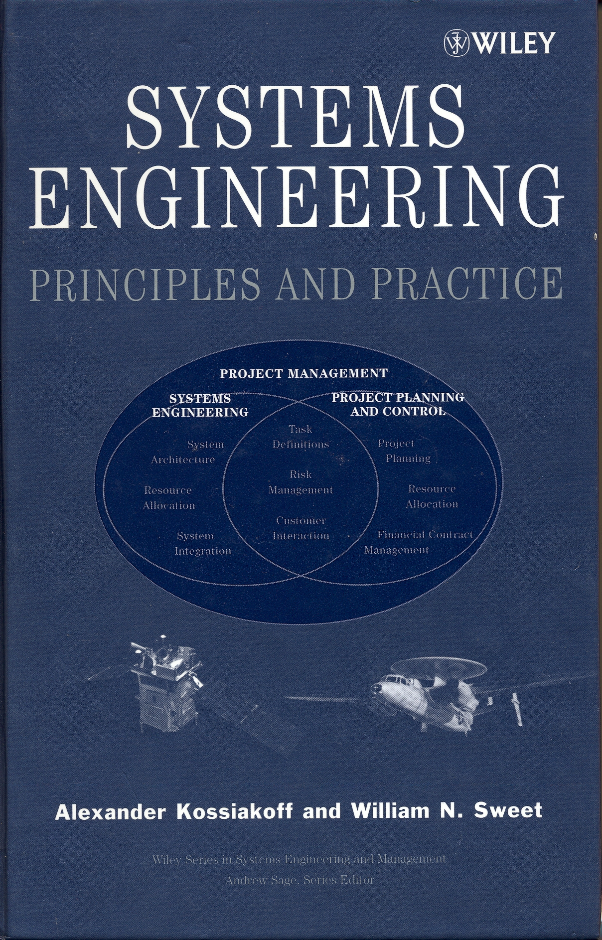


Texts for the course
Optional
Required
Required
Notes:
Kossiakoff and Sweet is a good optional text. Kossiakoff and Sweet is organized around life cycle phases where the course is organized around topics that cross the life cycle phases. Still Kossiakoff and Sweet is a very good text/ Readings must be completed in Johnson’s “Secrets of Apollo” and Chiles “Inviting Disaster”

Slide 17
Reading Assignments
Kossiakoff and Sweet, Systems Engineering Principle and Practice is intended as a optional reference textbook
  It takes a life cycle approach to systems engineering during systems development
  This is a classic view and useful but does not address the problems of systems engineering in operational programs
  There will not be assigned readings or problems from this book
Even though Johnson is about NASA and Apollo, it describes in detail the evolution of military systems engineering practices discussing aircraft as well as ballistic missiles
Most mishap reports describe lack of systems engineering as a contributing factor so it is worthwhile to understand high tech catastrophes. Chiles book is an excellent review of the types of factors that cause high technology catastrophes spanning a wide range of space, aviation, energy and construction industries.
Readings will be assigned by certain date and you will submit answers to questions from the chapter. We will discuss the chapters in class and there will be questions from the readings on the exams

Slide 18
Items from the course on the FE exam/PE Exam
Subjects to be covered that are typically on the Fundamentals of Engineering (FE/EIT) exam include:
  Reliability calculations
  Flowchart methodology
  Engineering probability and statistics
  Engineering Economics
  Spreadsheets for engineering calculations
  Feedback Control System Block Diagrams and their reduction

